Slide 1




Francy Fu, Jim Cloud, William Hibner, Patrick Yu
Vehicle Accident Locations Near WashU

Slide 2
Our Inspiration
Safety - Where do vehicle accidents occur in and around Washington University
When do accidents occur?
Identify trends
Create awareness
Encourage change

Slide 3
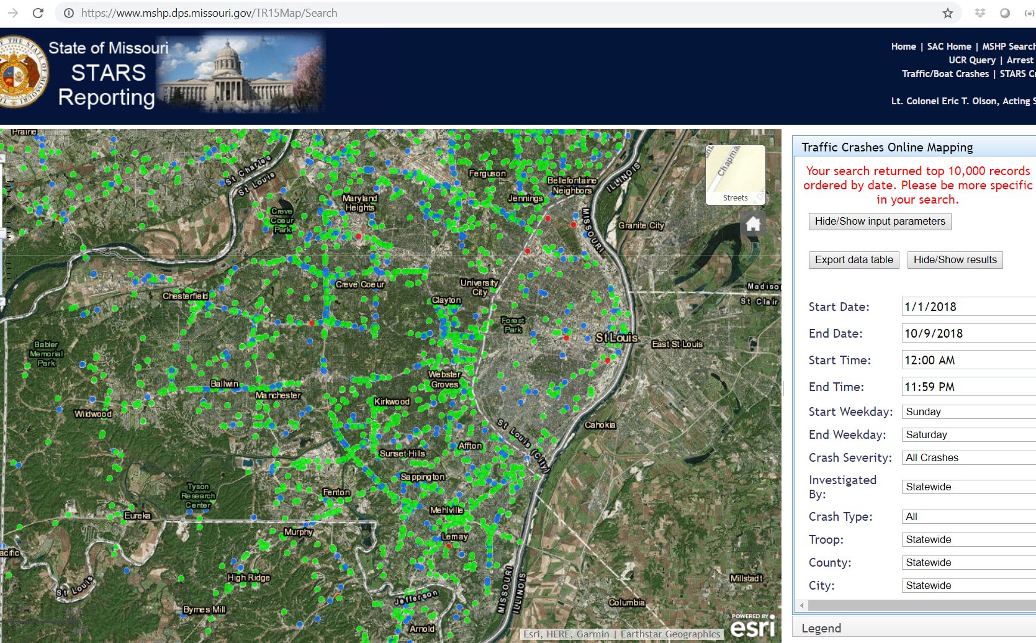
Data Source
Missouri State Highway Patrol Accident Data for City of St Louis, and St Louis County STARS - State Traffic Accident Reporting System

Slide 4
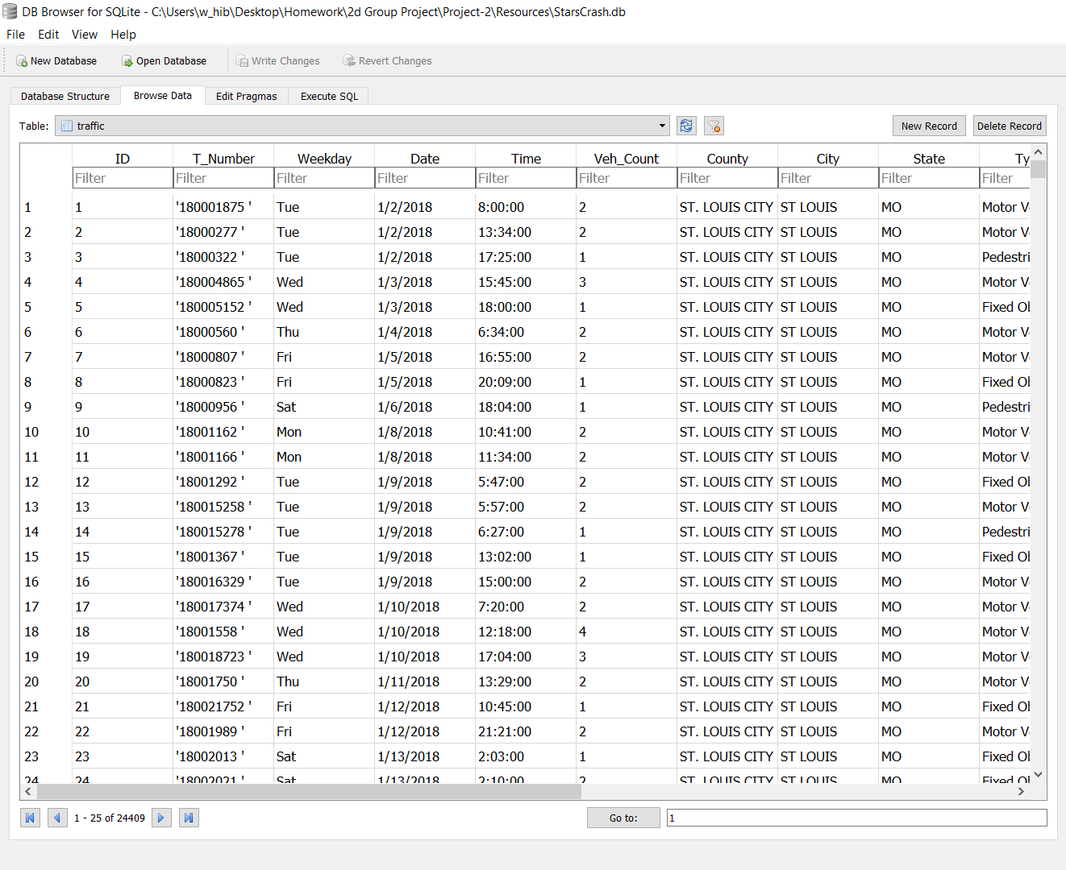
Data Munging
25, 400 records of accidents Jan – Oct 2018
Concatenate At & On Street locations to create an address
Converting address to Lat / Long utilizing an Excel Add-In
Some locations did not have enough info for a corresponding address

Slide 5
Data Snapshot
On average 86.5 accidents reported daily in & around WashU
147 fatal accidents recorded
959 accidents with injuries
Of 25,424 records 24, 409 had sufficient detail to create a Lat/Long to be plotted on a map
Most (6000) accidents occurred in unincorporated areas followed by Chesterfield, Florissant, & Maryland Heights each reporting 1000+ accidents

Slide 6
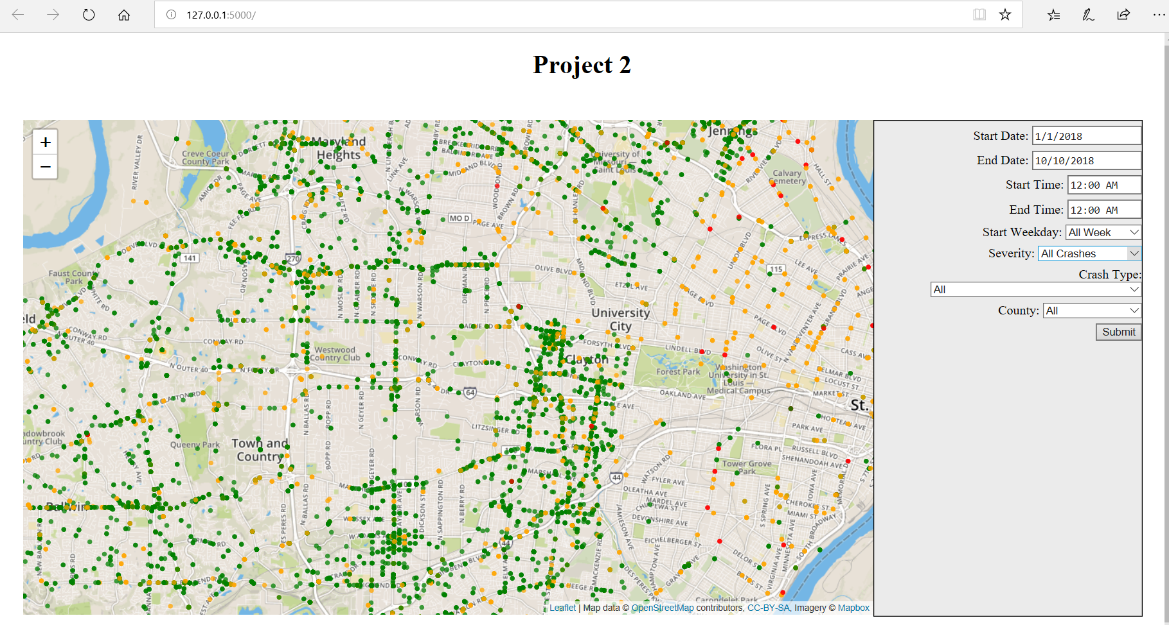

Slide 7
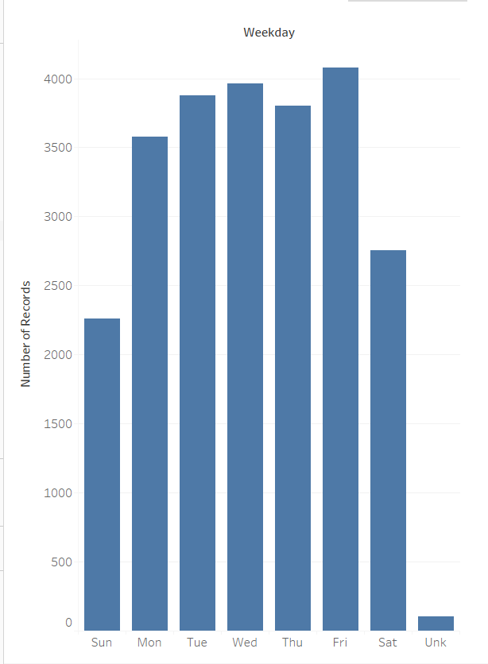
What Day of Week?
Accidents mostly occur during weekdays
Fridays have the greatest number of accidents
Sundays have the fewest accidents

Slide 8
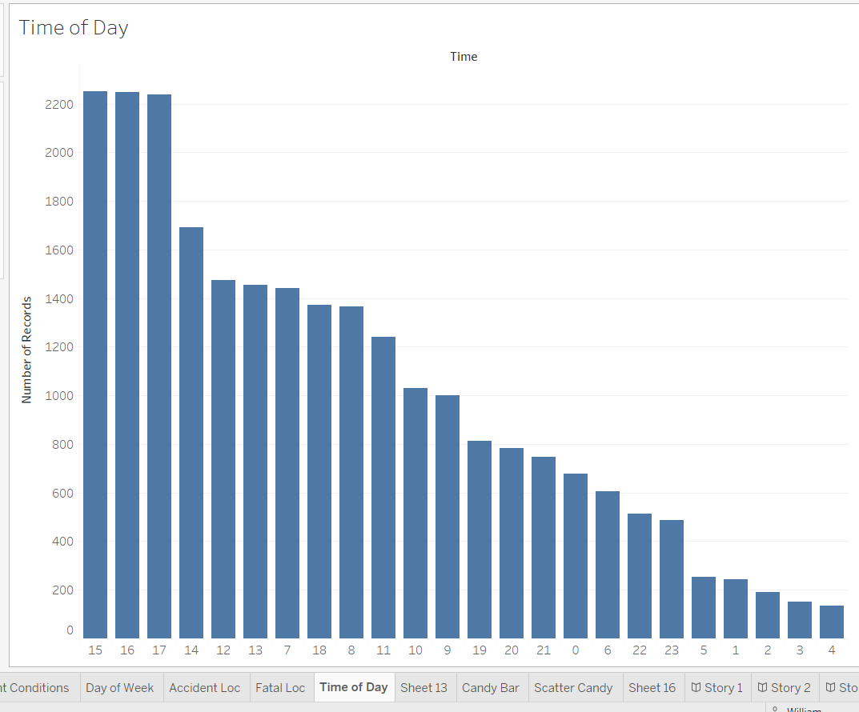
Time of Day
Accidents mostly occur 3-5pm
3-4 am have the fewest accident occurrences
24 Hour Clock

Slide 9
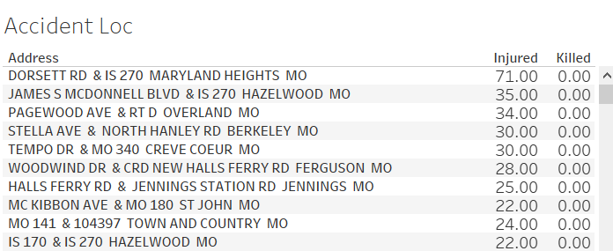
Locations with most injuries

Slide 10
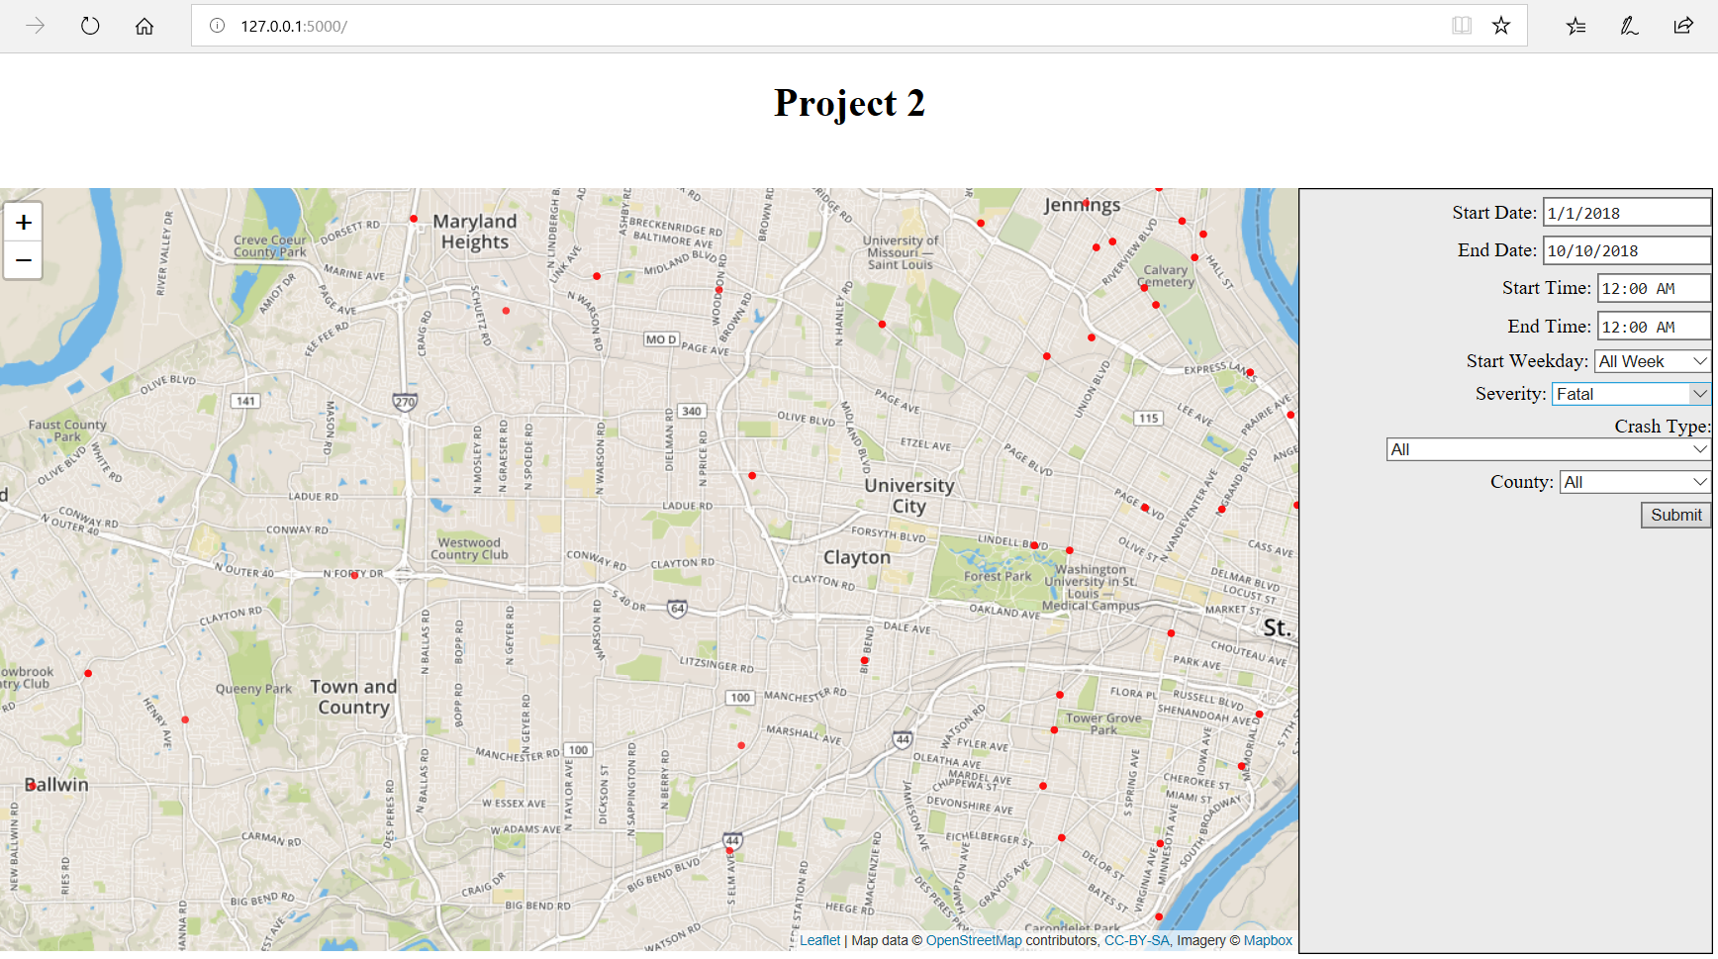

Slide 11
Conclusion
Avoid locations with most injuries
Most accidents occur late afternoons and early evenings
Speak to elected officials to make regulatory and infrastructure improvements
Accidents can and do occur at all hours of day – drive carefully

